Slide 1
The Fair Housing Act
Constructing Access to Community

Slide 2
Fair Housing Act of 1968
President Johnson signed into law the Fair Housing Act on April 11, 1968.
The 1968 Act prohibits discrimination concerning the sale, rental, and financing of housing based on five protected classes.
Race
Color
National Origin
Religion
Sex

Slide 3
Fair Housing Amendments Act, 1988
Twenty years later, President Reagan signed into law an amendment to the original Act, which added two additional protected classes.
Disability
Familial Status

Slide 4
Other Fair Housing Protections
Section 804 of the Act also prohibits discrimination against the seven protected classes in “the provision of services or facilities.”
Facilities and services could include access to benefits from federally assisted projects that provide:
Safe drinking water
Sanitary sewer service
Street improvements
Fire safety
Community centers
Health care facilities
ADA compliant ramps, sidewalks, and more…
Notes:
Sec. 804. [42 U.S.C. 3604] Discrimination in sale or rental of housing and other prohibited practices As made applicable by section 803 of this title and except as exempted by sections 803(b) and 807 of this title, it shall be unlawful—
(a) To refuse to sell or rent after the making of a bona fide offer, or to refuse to negotiate for the sale or rental of, or otherwise make unavailable or deny, a dwelling to any person because of race, color, religion, sex, familial status, or national origin. 4
(b) To discriminate against any person in the terms, conditions, or privileges of sale or rental of a dwelling, or in the provision of services or facilities in connection therewith, because of race, color, religion, sex, familial status, or national origin.
(f) (1) To discriminate in the sale or rental, or to otherwise make unavailable or deny, a dwelling to any buyer or renter because of a handicap of-- (A) that buyer or renter, (B) a person residing in or intending to reside in that dwelling after it is so sold, rented, or made available; or (C) any person associated with that buyer or renter.
(2) To discriminate against any person in the terms, conditions, or privileges of sale or rental of a dwelling, or in the provision of services or facilities in connection with such dwelling, because of a handicap of-- (A) that person; or (B) a person residing in or intending to reside in that dwelling after it is so sold, rented, or made available; or (C) any person associated with that person.

Slide 5
Texas CDBG Program - Access to Community
Project by project the TxCDBG Program provides improved access to community assets.

Slide 6
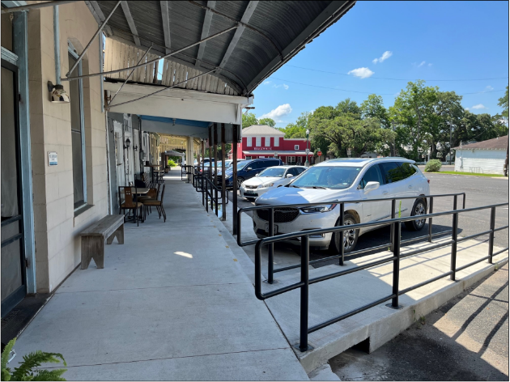
Access to Community
Downtown Revitalization – ADA Compliant Ramps and Sidewalks

Slide 7
Access to Community
Community Development – First-time Water Projects
[INSERT PHOTO HERE]

Slide 8
Access to Community
FAST Fund – Enhanced access to First Responder Services

Slide 9
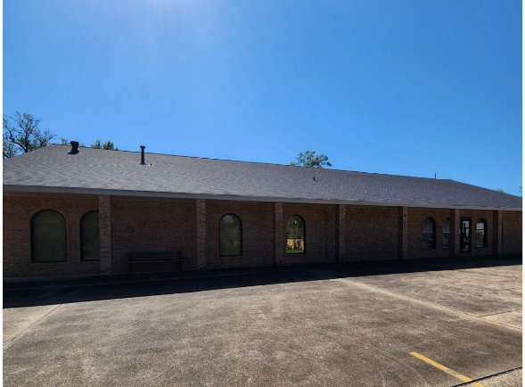
Access to Community
Community Development – Senior Center

Slide 10
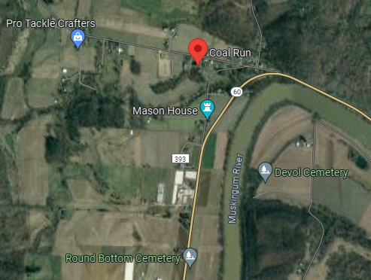
Equitable Access
Ensuring that all persons in protected classes are afforded equitable access to community assets is an important consideration in planning and funding proposed projects.
Denying access could result in formal complaints and even litigation.
In 2008, a jury in Ohio awarded the residents of Coal Run, an unincorporated community, nearly $11 million dollars for violations of the Fair Housing Act alleging denial of public water service on the basis of race.

Slide 11
Legacy of the HCDA
Nearly 50 years ago on August 22, 1974, President Ford signed into law the Housing and Community Development Act (HCDA).
Created the CDBG program.
Gave subgrantees/local governments greater control over what activities they could fund.

Slide 13
Question or Comments
https://www.nhaustin.com/training-and-certifications/course-outline/id/1000401014/c/adobe-indesign-cc-part-1

